Slide 1
Vector Subtraction

Slide 2
Lesson Objectives
Demonstrate vector subtraction for right angle triangles.
Apply understanding to obtuse angle triangles.
Explain subtraction of vectors for acute angle triangles.

Slide 3
Vector Subtraction – Right Angle Triangle

Slide 4
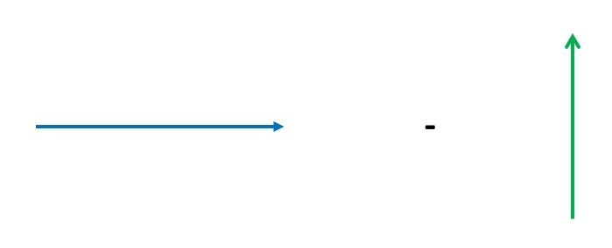
Reverse the direction of the subtracted vector and then add

Slide 5
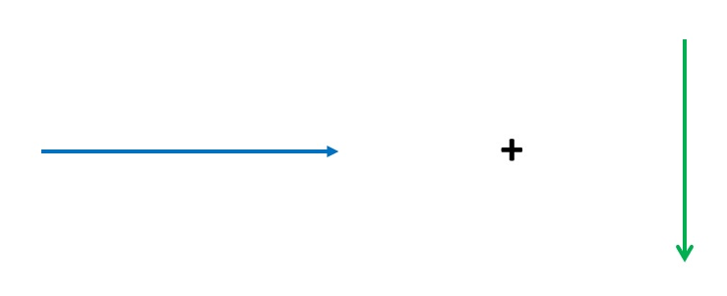
Vector Subtraction – Right Angle Triangle

Slide 6
Example 1
A
B
✓
C
D

Slide 7
Example 2
A
B
✓
C
D

Slide 8
Vector Subtraction – Obtuse Angle Triangle

Slide 9
Reverse the direction of the subtracted vector and then add

Slide 10
Vector Subtraction – Obtuse Angle Triangle

Slide 11
Example 3
✓
A
B
C
D

Slide 12
Example 4
A
B
✓
C
D

Slide 13
Vector Subtraction – Acute Angle Triangle

Slide 14
Reverse the direction of the subtracted vector and then add

Slide 15
Vector Subtraction – Acute Angle Triangle

Slide 16
Example 5
B
A
C
D
✓

Slide 17
Example 6
✓
B
A
C
D

Slide 18
Lesson Objectives
Demonstrate vector subtraction for right angle triangles.
Apply understanding of subtraction to obtuse angle triangles.
Explain subtraction of vectors for acute angle triangles.
✓
✓
✓

