Slide 1
Density
Past Paper Question 6 marks
Name: Date:

Slide 2
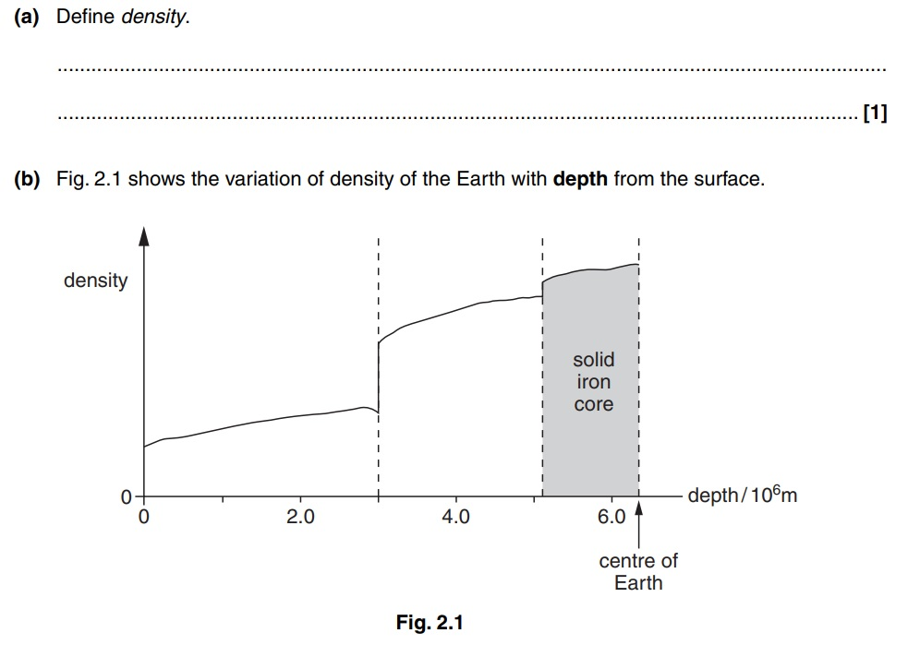

Slide 3
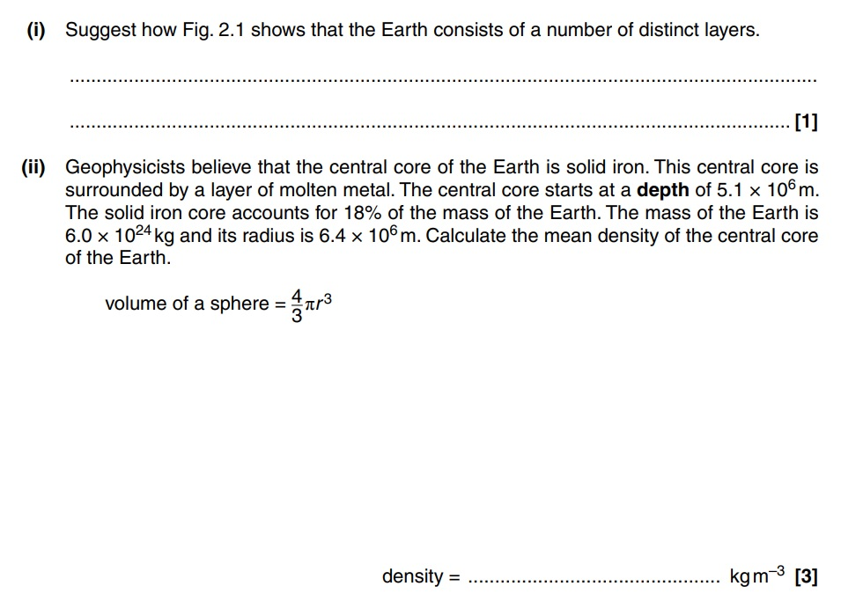
State
Displacement
[4]

Slide 5
Density
Past Paper Question 6 marks Answers
Name: Date:

Slide 6
Define
Mass/Volume or Mass per unit Volume
[1]

Slide 7
Suggest
There are 2 major changes in Density
[1]
Calculate
Mass of core = 0.18 x 6.0x10²⁴ = 1.08x10²⁴ (kg)
Radius of core = (6.4-5.1)x10⁶ = 1.3x10⁶ (m)
Volume = 4/3 π r 3 = 4/3 π (1.3x10⁶)³ = 9.20 x 10¹⁸ (m³)
State
ρ = m / V = 1.08x10²⁴ / 9.20 x 10¹⁸ = 1.17 x 10⁵
Displacement
ρ = 1.2 x 10⁵
[4]
[4]

